Slide 1




THAI MOBILE APP NOTIFICATION FILTER

Slide 2
OVERVIEW
Aiming at classifying mobile application notifications into two categories:
"ham" (bill reminding, delivery noticing,
non-advertising related)
"spam" (marketing, advertising related, etc.)
Solving the issue of receiving mixed notifications like
delivery status updates and marketing offers,
from mobile applications

Slide 3



Slide 4
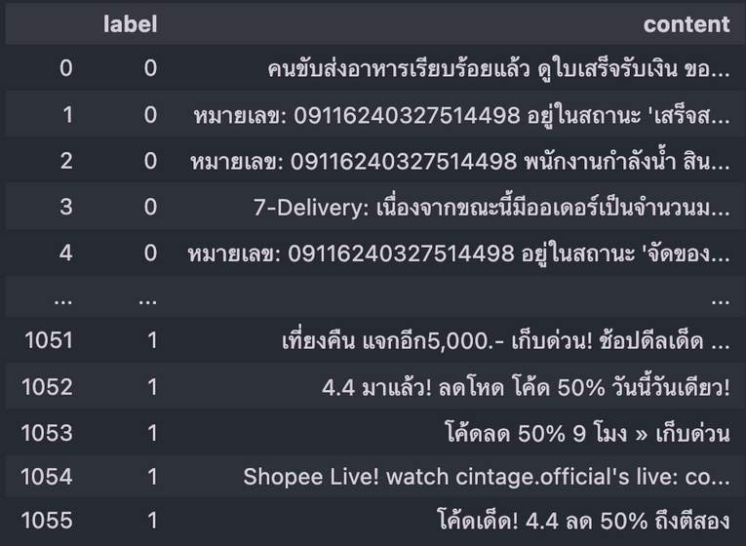
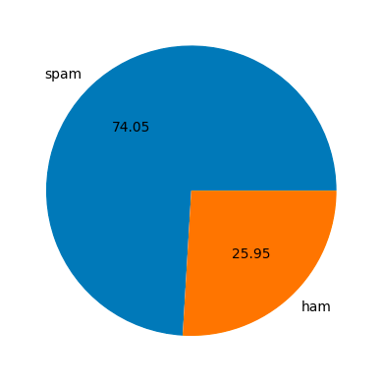
DATASET
Dimension of dataset: (1056, 2)
LABEL : "HAM" OR "SPAM"
CONTENT : TEXT OF THE NOTIFICATION
MAINLY IN THAI LANGUAGE FOCUSING ON SHOPPING, FOOD DELIVERY, AND SERVICE-RELATED APPLICATIONS.

Slide 5
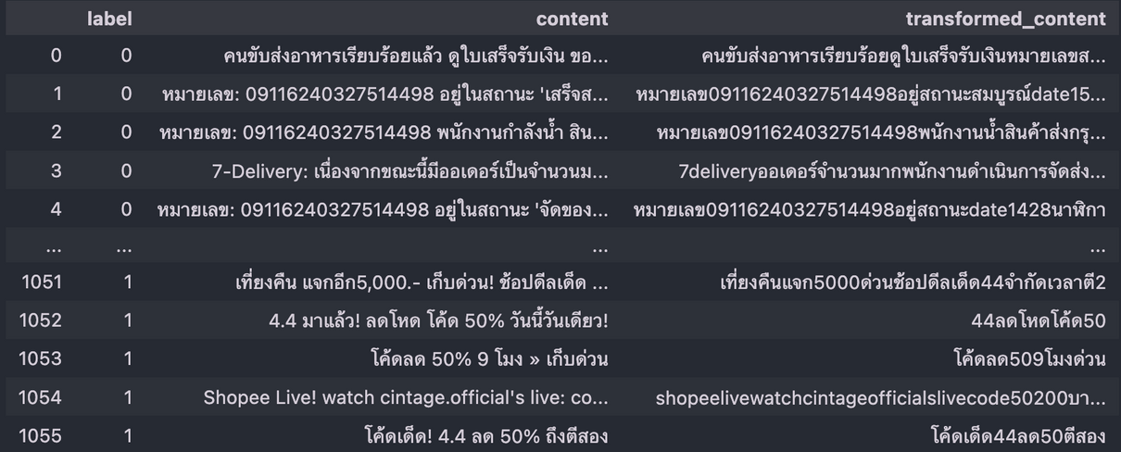
PREPROCESSING
Thai language behavior is handled differently from English language, which we handle these following steps to streamline the feature set for modeling
01 - REMOVING ACRONYMS
02 - SUBSTITUTING DATES WITH A GENERIC PLACEHOLDER
03 - REMOVE STOP WORDS AND NON-THAI/ALPHANUMERIC CHARACTERS

Slide 6
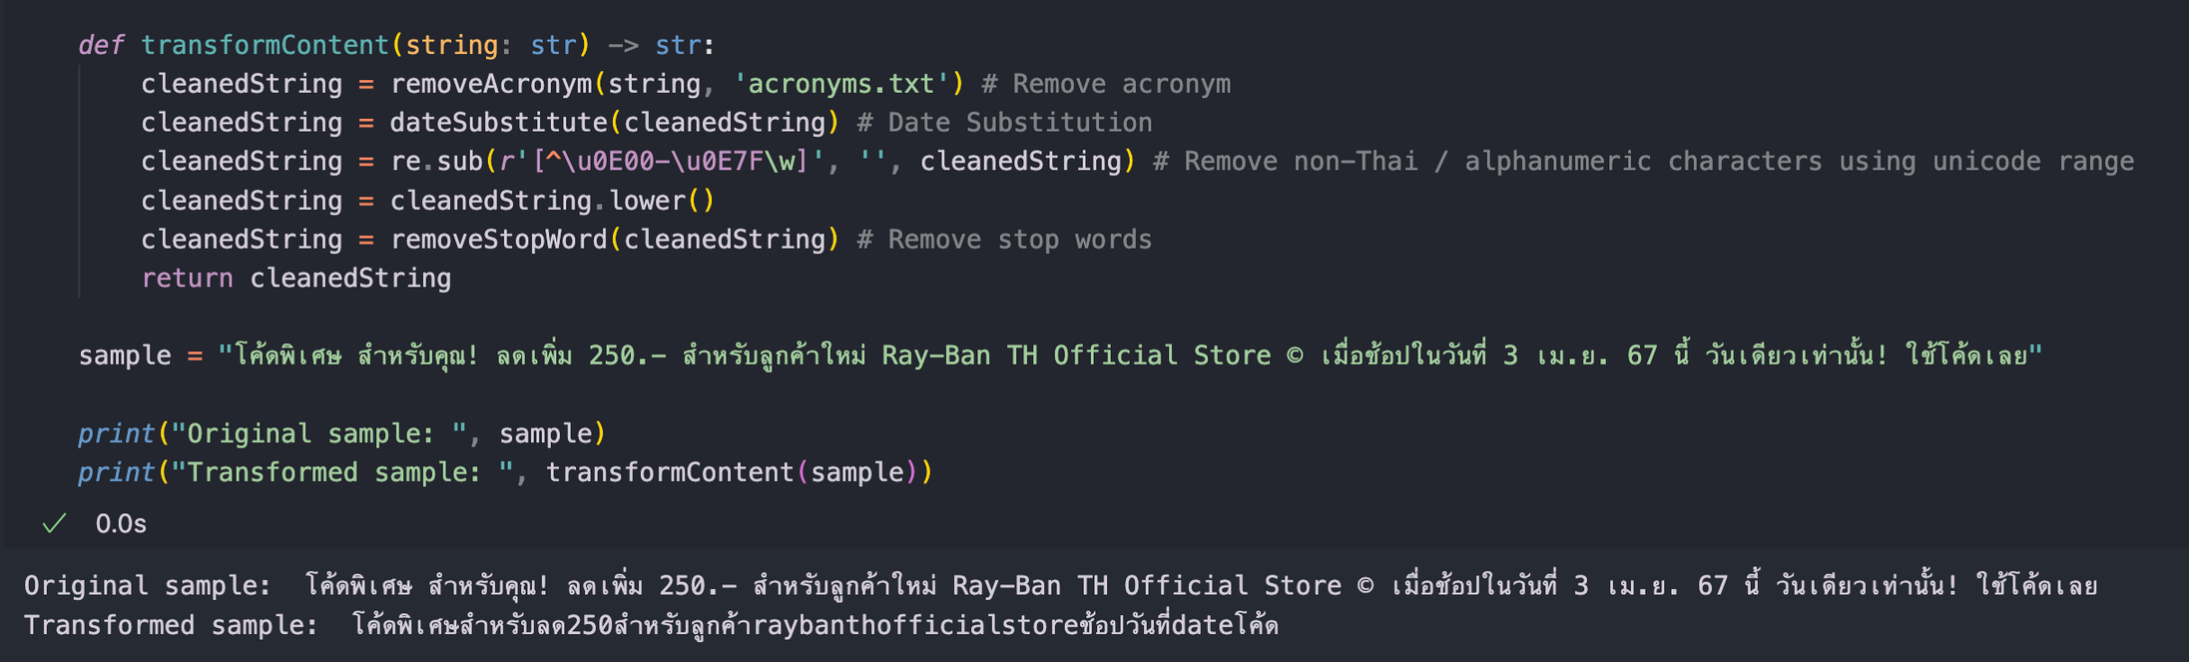
PREPROCESSING SAMPLE

Slide 7
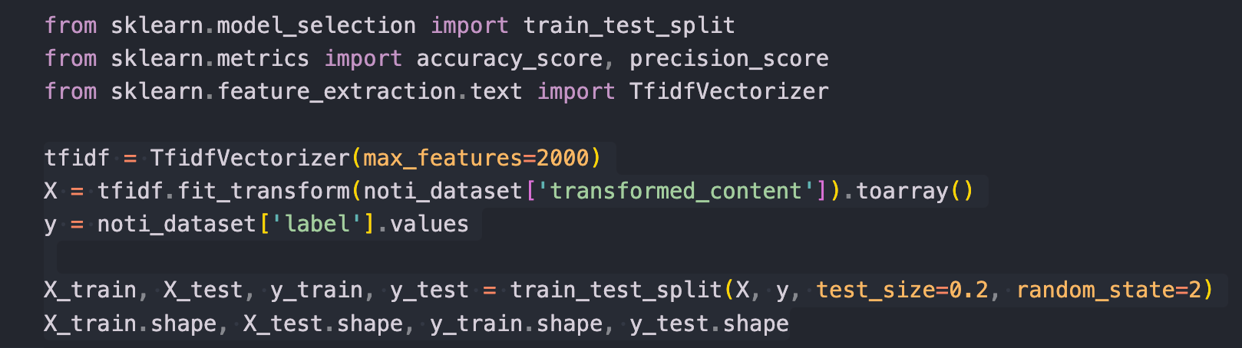
PREPROCESSING
TfidfVectorizer
A method for converting a collection of raw documents into a matrix of TF-IDF (Term Frequency-Inverse Document Frequency) features
train_test_split : Train 80% / Test 20%

Slide 8
MODEL SELECTION MULTINOMIAL NAIVE BAYES
Multinomial Naive Bayes Classifier
In practice
based on Bayes' theorem, the assuming that the features (words) are conditionally independent given the class label.
Real-world applications show that MNB perform well on text classification tasks, like spam detection.
2
4
1
3
Text Classification Task
Robust to
categorizing text documents or messages into predefined classes based on their content.
irrelevant features
noisy data

Slide 9
MODEL
TRAINING

Slide 10

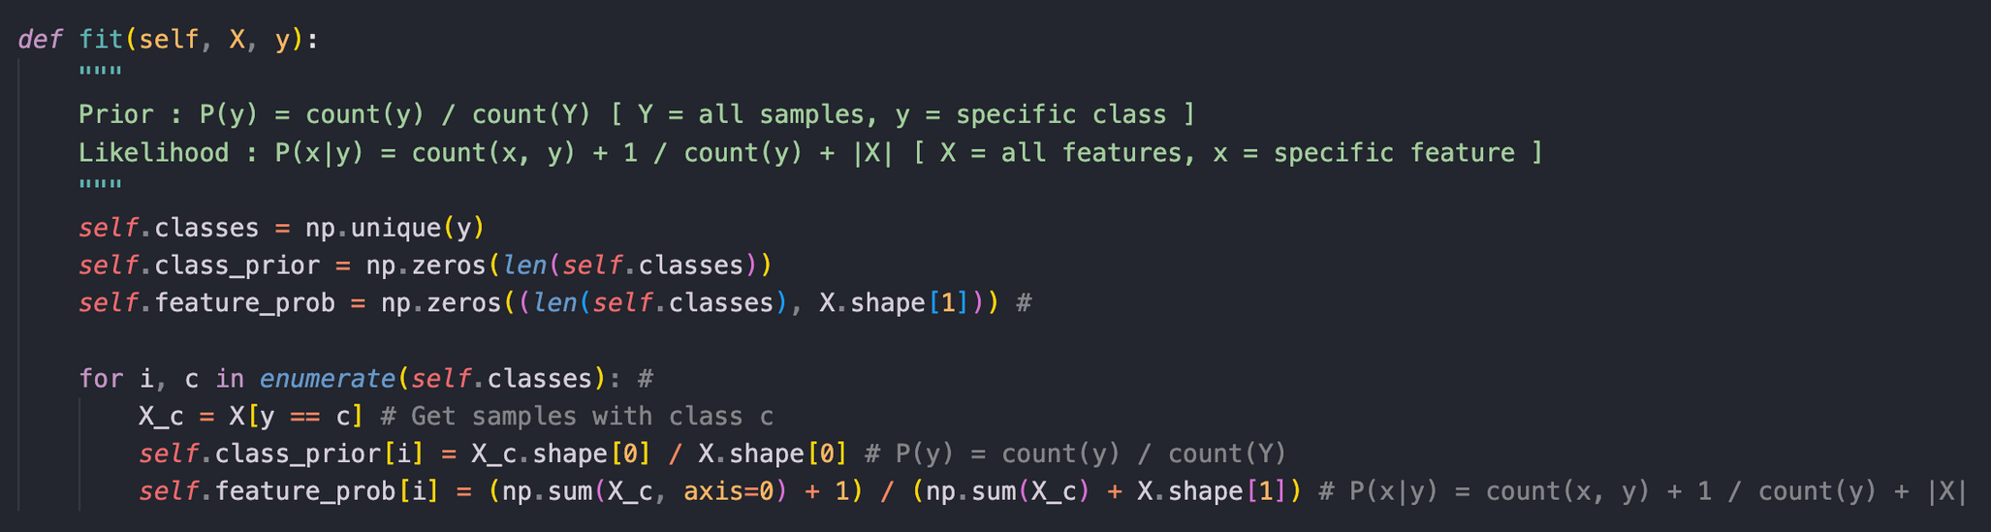
FIT
Compute the P(y) (Prior) and P(x|y) (Likelihood)
P(y) = count(y) / count(Y) [ Y = all samples, y = specific class ]
P(x|y) = count(x, y) + 1 / count(y) + |X|
[ X = all features, x = specific feature ]

Slide 11
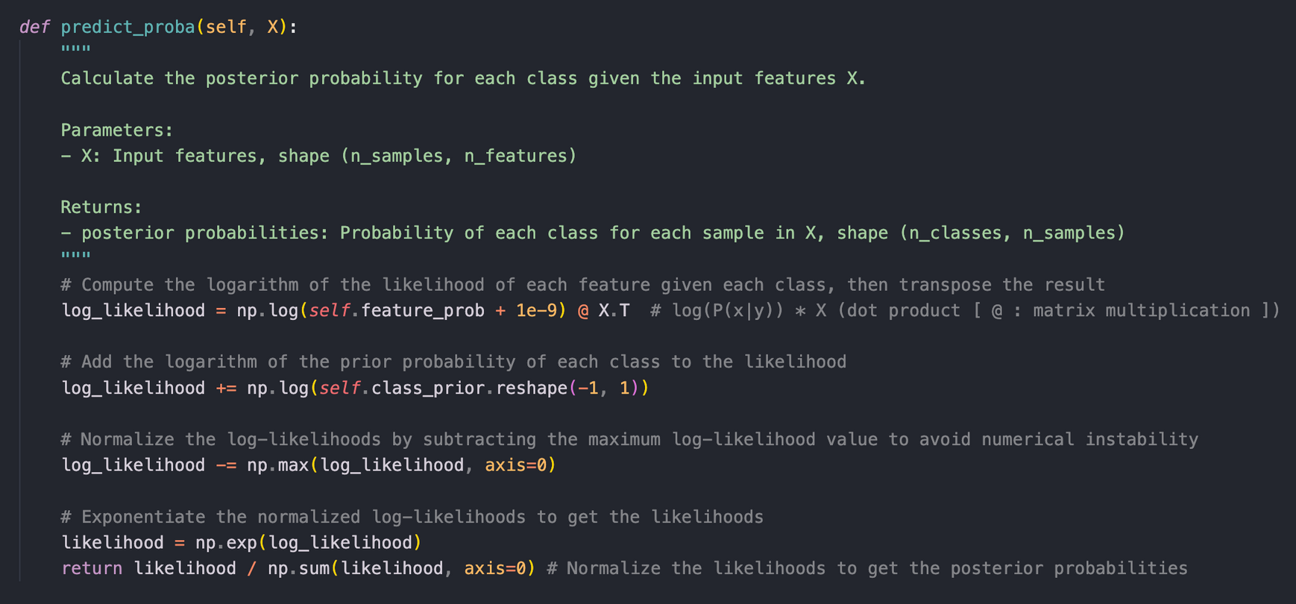
PREDICT PROBABILITY
log_likelihood = log(P(x∣y)) × XT
Compute log of the likelihood of each feature given each class
Use feature probabilities learned during model training phase

Slide 12
PREDICT PROBABILITY
log_likelihood += log(P(y))
Adds log of the prior probability of each class to log-likelihood
Adjusts likelihoods based on the prior probability of each class

Slide 13
PREDICT PROBABILITY
log_likelihood −= max(log_likelihood)
log-likelihood normalization, performed to address numerical instability issues which occur when dealing with very small or very large values ( logarithms )

Slide 14
PREDICT PROBABILITY
likelihood = exp(log_likelihood)
posterior_prob = likelihood / ∑ likelihood

Slide 15
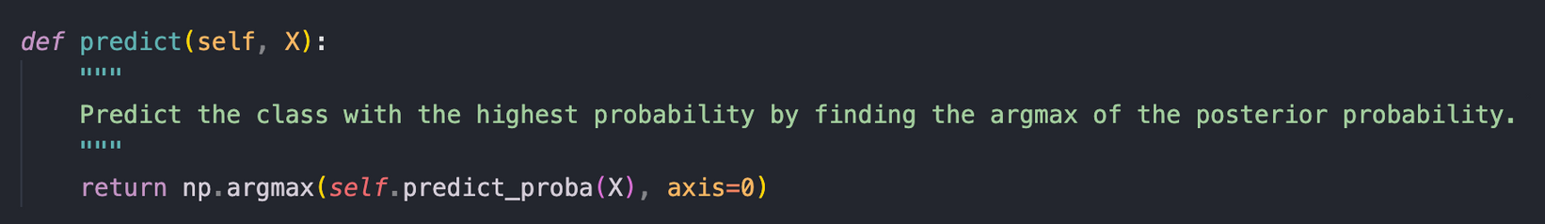

CLASS PREDICTION
Selects the class with the highest probability ( argmax )
as the predicted class for each sample

Slide 16
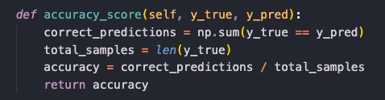
PERFORMANCE METRICS
measures the proportion of correctly classified samples out of the total number of samples
Accuracy = Number of Correct Predictions​ / Total Number of Predictions

Slide 17
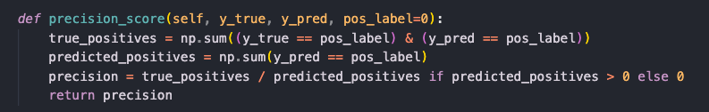
PERFORMANCE METRICS
Measure of the accuracy of positive predictions made by the model
Precision = True Positives / True Positives + False Positives​
Indicates the model's ability to avoid false positive predictions.

Slide 18
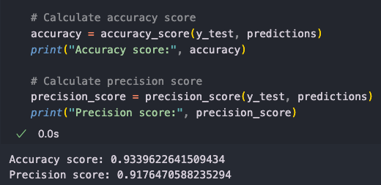
PERFORMANCE METRICS

Slide 19
REFERENCES
Multinomial Naive Bayes
Cornell University - CS4780 Lecture Notes
Slides
Colorful Modern Business Infographic Presentation

